Slide 1
Comparative Study of Classical and Neural Retrieval Methods for FANDOM Wikis
KP/FP/MP DB Anwendungsentwicklung
Gruppe Information Retrieval

Slide 2
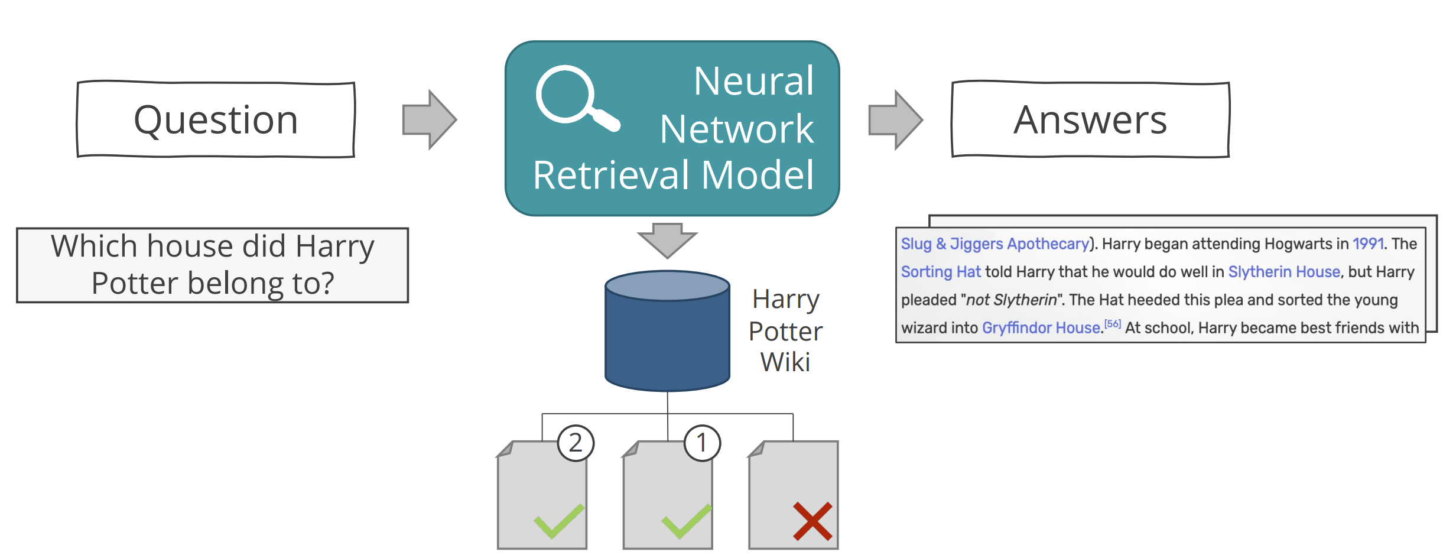
Task: Semantic Retrieval for FANDOM Wikis
Setting: find the best-k matching passages that answers a given question written by a user

Slide 3
Overall Plan
1. Extract Wikis + Dataset Generation
2. Implementation of Retrieval Methods
3. Training & Evaluation of our Retrieval Methods
4. Model Understanding and Interpretability
5. Demo System

Slide 4
Wiki Extraction and Dataset Generation FANDOM-QA & MS MARCO

Slide 5
Wikis and Datasets
FANDOM-QA Dataset
MSMARCO Dataset
Harry Potter
Star Wars
MSMARCOv1
Marvel
MSMARCOv2
Elder Scrolls
Witcher

Slide 6
FANDOM-QA Dataset
Elder Scrolls Wiki
Harry Potter Wiki
…
‘Where does Harry live?’, ‘Who lives in London?’
‘Who is Snape?’, ‘Who lives in Paris?’
‘Harry lives in London’
Passage
Positive Queries
Negative Queries

Slide 7
Creating the FANDOM-QA Dataset
Harry Potter Wiki
<!DOCTYPE html>
<html class="client-nojs" lang="en" dir="ltr">
<head>
<meta charset="UTF-8"/>
<text>Harry lives in London. He is 12.</text>
1
2
2
‘Where does Harry live?’, ‘Who lives in London?’
‘Who is Snape?’, ‘Who lives in Paris?’
‘Harry lives in London’
Passage
Positive Queries
Negative Queries

Slide 8
FANDOM-QA – 1. Step: Passage Generation
Harry Potter Wiki
<!DOCTYPE html>
<html class="client-nojs" lang="en" dir="ltr">
<head>
<meta charset="UTF-8"/>
<text>Harry lives in London. He is 12.</text>
WikiExtractor
‘Harry lives in London. He is 12.’
Further Processing
‘Harry lives in London’
‘He is 12.’
Passages
Notes:
Further Processing
Merging if too short
Splitting if too long
Remove corrupted sites without information

Slide 9
FANDOM-QA – 2. Step: Query Generation
Passage Generation
Passage
‘Harry lives in London’
Prompt
You are given this passage from a fandom article: ‘Harry lives in London’ Please generate 2 questions that are answered by the passage paragraph and 2 questions that are not answered by it. Try to use synonyms in your questions. The output !!MUST!! be in the following form:
1. <answered-question-1> 2. <answered-question-2> 1. <unanswered-question-1> 2. <unanswered-question-2>
GPT4Free Frontends
1. <Where does Harry live?> 2. <Who lives in London?>
1. <Who is Snape?> 2. <Who lives in Paris?>
Regex
Positive Queries
Negative Queries
Where does Harry live?, Who lives in London?
Who is Snape?, Who lives in Paris?
Notes:
Problem when implementing the naive way:
time is mostly spent on waiting on the website to answer.
Gpt frontends timeout ips after a certain amount of requests
> not suited for the amount data we have

Slide 10
FANDOM-QA – 2. Step: Batch Query Generation
Passages
Proxies
...
...
uses
uses
Passage Generation
Passage Generation
…
Thread 1
Thread 2

Slide 11
FANDOM-QA
Elder Scrolls Wiki
Harry Potter Wiki
…
QA Elder Scrolls
QA Harry Potter
Train
Val
Train
Val
Train
Val
Fandom-QA

Slide 12
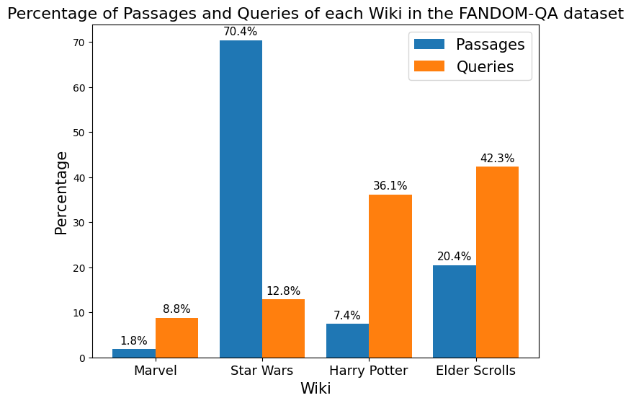
Statistics on Datasets

Slide 13
Human Verified Dataset
consists of 2870 queries generated and verified by us
initially for training purposes
→ did not significantly improve the model
→ instead used as a clean validation dataset

Slide 14
MS-MARCO Dataset
common benchmark dataset, used for comparing retrieval systems
Question-answering dataset featuring real Bing questions and human verified answers and not fitting answers
used for comparison with ColBERTv2.0 and other retrieval systems

Slide 15
MS-MARCO Dataset
Gold Standard Dataset used for many retrieving systems
Question answering dataset featuring real Bing questions and a human verified answer and not fitting answers
Used for comparison with ColBERTv2.0

Slide 16
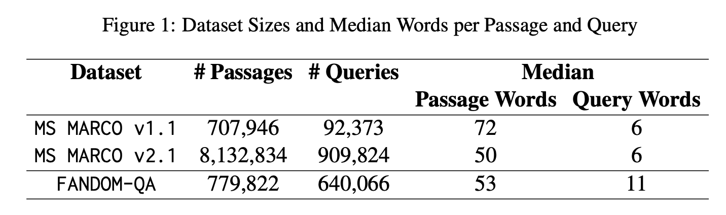

Slide 17
Retrieval Methods

Slide 18
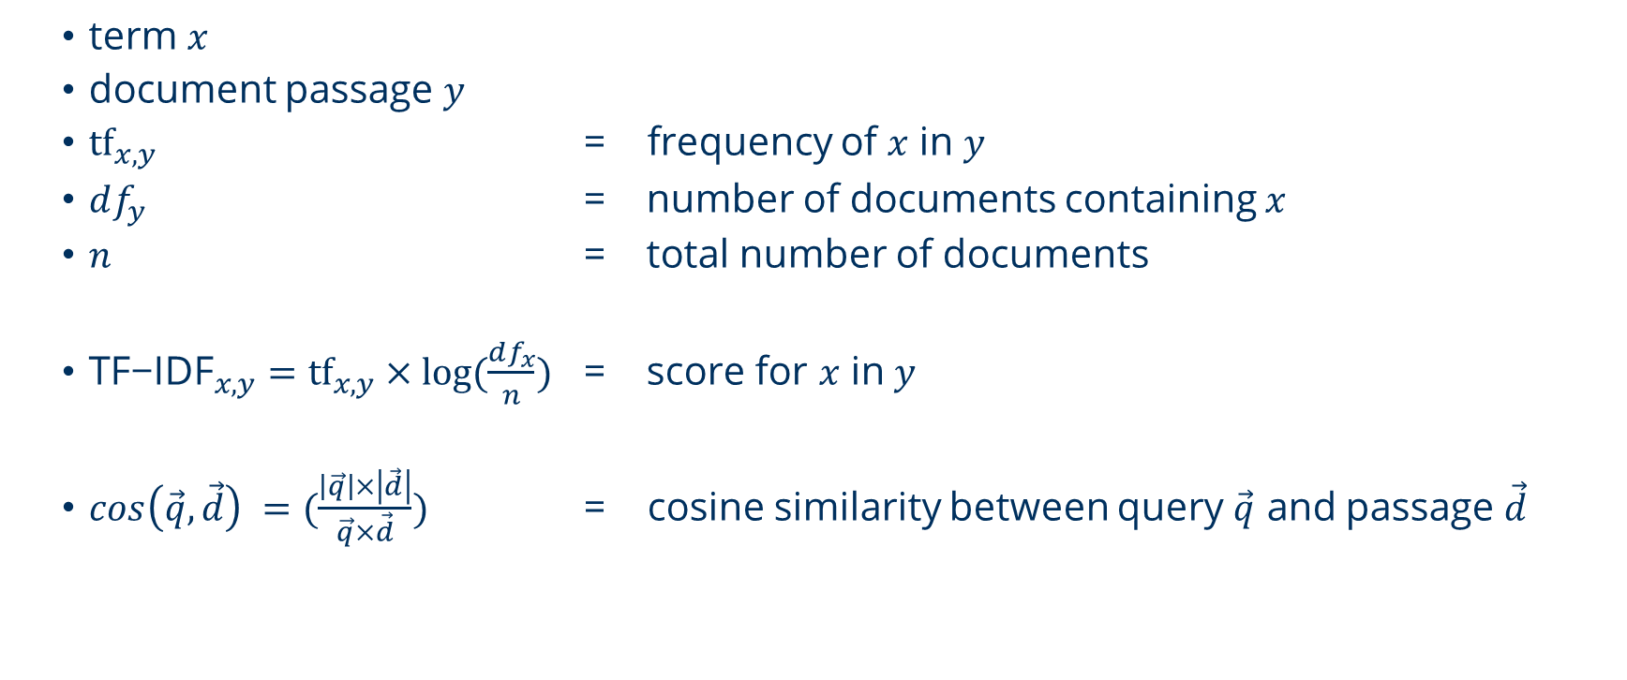
Term Frequency-Inverse Document Frequency (TF-IDF)
term $x$
document passage $y$
${tf}_{x,y}$ = frequency of $x$ in $y$
$df_{y}$ = number of documents containing $x$
$n$ = total number of documents
${\text{TF}\text{−}\text{IDF}}_{x,y}={tf}_{x,y}×log⁡(\frac{df_{x}}{n})$ = score for $x$ in $y$
$cos\left(\vec{q}, \vec{d}\right) =(\frac{\left|\vec{q}\right|×\left|\vec{d}\right|}{\vec{q}×\vec{d}})$ = cosine similarity between query $\vec{q}$ and passage $\vec{d}$

Slide 19
ColBERT
Contextualized Late Interaction over BERT
neural retrieval method which measures the semantic similarity between a query Q and a document/passage D and returns a single similarity score
by comparing Q with a set of documents {D₁, D₂, ..., D_{l}}, we can rank the documents based on their similarity to Q
→ model can be used for non-generative question answering over a given database
needs to be trained on a dataset

Slide 20

ColBERT – Big Picture
Score
$$Σ$$
MaxSim
MaxSim
MaxSim
Query Embeddings
Document Embeddings
Transformer Encoder
Transformer
Encoder
Note: the same encoder is used for query and documents
Query Tokens
Document Tokens

Slide 21

ColBERT – Big Picture
Score
$Σ$
MaxSim
MaxSim
MaxSim
Query Embeddings
Document Embeddings
Transformer Encoder
Transformer
Encoder
Note: the same encoder is used for query and documents
Query Tokens
Document Tokens

Slide 22
ColBERT - Tokenization
How old was ... ?
Tokenization (Vocabulary: 30k or 50k Token)
How
old
was
...
?
Preprocessing
[Q]
[CLS]
How
old
was
...
?
[SEP]
[MASK]
[D]
[Q]/[D] token is used to encode the type of the input
queries are padded up to a constant length N_{q} using [MASK] tokens
passages are truncated after a length of L_{d}

Slide 23

ColBERT – Big Picture
Score
$$Σ$$
MaxSim
MaxSim
MaxSim
Query Embeddings
Document Embeddings
Transformer Encoder
Transformer
Encoder
Note: the same encoder is used for query and documents
Query Tokens
Document Tokens

Slide 24
ColBERT - Embedding
[CLS]
[Q]
How
old
was
...
?
[SEP]
[PAD]
Word Emb. + Pos. Emb.
...
768-dimensional embeddings without contextual information
Transformer Encoder (BERT / RoBERTa)
...
768-dimensional embeddings with contextual information
Linear Mapping
24 or 128-dimensional embeddings with contextual information
q₁
q₂
q₃
q₄
q₅
...
q_{Nq-2}
q_{Nq-1}
q_{Nq}

Slide 25
ColBERT – Big Picture
Score
$$Σ$$
MaxSim
MaxSim
MaxSim
Query Embeddings
Document Embeddings
Transformer Encoder
Transformer
Encoder
Note: the same encoder is used for query and documents
Query Tokens
Document Tokens

Slide 26

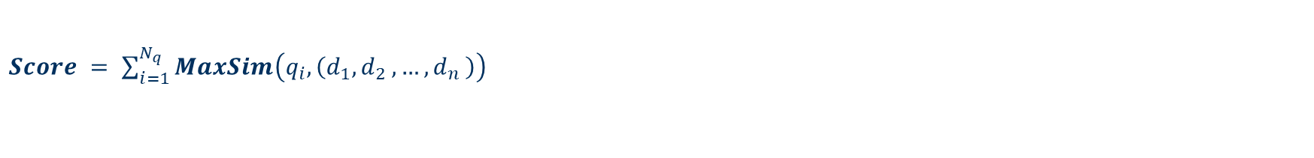
ColBERT – Similarity Calculation
Score
$$Σ$$
Sum of
maximum similarity (SMS)
MaxSim
MaxSim
MaxSim
Query Embeddings
q_{i-1}
q_{i}
q_{i+1}
d₁
d₂
d₃
...
d_{n}
Document Embeddings
$$MaxSim\left(q_{i},\left(d_{1}{,d}_{2}{,…,d}_{n}\right)\right)=\max_{k = 1,…,n}{sim(q_{i},d_{k})}$$
with ${sim}_{cos}(q_{i},d_{k})= \frac{{q_{i}}^{T}d_{k}}{\left|\left|q_{i}\right|\right| \left|\left|d_{k}\right|\right|}$ or ${sim}_{L2}\left(q_{i},d_{k}\right)=−\left|\left| \frac{q_{i}}{\left|\left|q_{i}\right|\right| } − \frac{d_{k}}{\left|\left|d_{k}\right|\right| } \right|\right|²$
$Score = \sum_{i=1}^{N_{q}}{MaxSim\left(q_{i},\left(d_{1}{,d}_{2}{,…,d}_{n}\right)\right)}$

Slide 27
ColBERT – Retrieval
Precompute the document embeddings offline:
document embedding matrix
...
ColBERT
ColBERT
ColBERT
D₁
D₂
D₃

Slide 28
ColBERT – Retrieval: Re-ranking
Query
document database
ColBERT
TF-IDF
D₂
D₁
D₃
...
top-k passages
ranked by TF-IDF
D₂:
D₁:
D₃:
precomputed document embeddings
Sum of MaxSim
Sum of MaxSim
Sum of MaxSim
D₂-score: 0.6
D₁-score: 0.8
D₃-score: 0.9
D₃
D₁
D₂
...
top-k passages
re-ranked by ColBERT

Slide 29


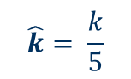

ColBERT – Retrieval: End-to-end
precomputed document embeddings
Query
ColBERT
top-$\hat{k}$ Sim
top-$\hat{k}$ Sim
top-$\hat{k}$ Sim
$$\hat{k}= \frac{k}{5}$$
...
...
...
Unqiue documents:
D₁, D₂, D₃,
D₁:
D₂:
D₃:
Sum of MaxSim
Sum of MaxSim
Sum of MaxSim
D₃
D₁
D₂
...
top-k passages
end-to-end retrieved
by ColBERT

Slide 30
Results

Slide 31
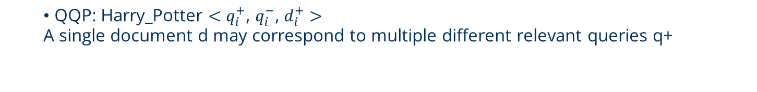
2 type of datasets:
QPP: MS MARCO v2.1 ${<q}_{i}^{+}$, $d_{i}^{+}$, $d_{i,1}^{−}$, $…$ , $d_{i,9}^{−}>$
A single query q may correspond to multiple different relevant documents d+
QID | PID+ | PID- | PID- | PID- | PID- | PID- | PID- | PID- | PID-
26 | 258 | 259 | 261 | 262 | 263 | 264 | 266 | 267 | 262
26 | 260 | 259 | 261 | 262 | 263 | 264 | 266 | 267 | 262
26 | 265 | 259 | 261 | 262 | 263 | 264 | 266 | 267 | 262
PID-
266
266
266
QQP: Harry_Potter ${<q}_{i}^{+}$, $q_{i}^{−}$, $d_{i}^{+}>$
A single document d may correspond to multiple different relevant queries q+
QID+ | QID- | PID
535060 | 535061 | 225618
535062 | 535063 | 225618

Slide 32
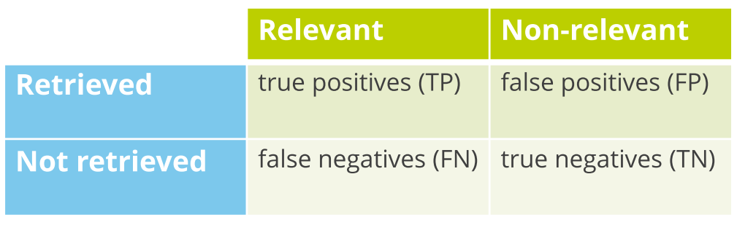
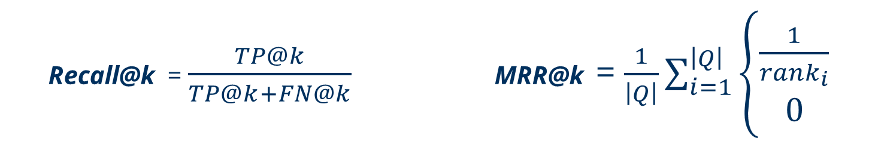
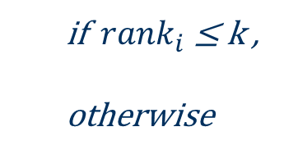
Metrics
Recall@k = $\frac{TP@k}{TP@k+FN@k}$ MRR@k = $\frac{1}{\left|Q\right|}\sum_{i=1}^{\left|Q\right|}{\left\{\begin{aligned}\frac{1}{{rank}_{i}} \\ 0 \end{aligned}\right.}$
if ${ rank}_{i}$≤ k ,
otherwise
MRR：Mean Reciprocal Rank

Slide 33
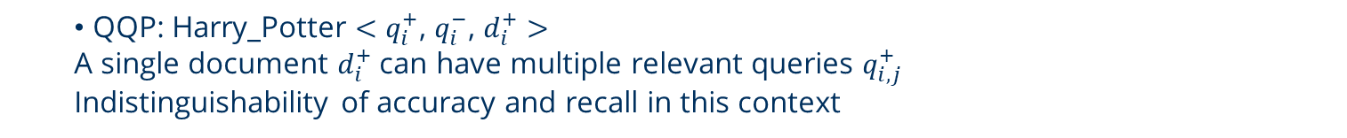
Why no accuracy?
QPP: MS MARCO v2.1 ${<q}_{i}^{+}$, $d_{i}^{+}$, $d_{i,1}^{−}$, $…$ , $d_{i,9}^{−}>$
A single query $q_{i}^{+}$can have multiple relevant documents $d_{i,j}^{+}$
Using Recall instead of accuracy to account for this variability.
QID | PID+ | PID- | PID- | PID- | PID- | PID- | PID- | PID- | PID-
26 | 258 | 259 | 261 | 262 | 263 | 264 | 266 | 267 | 262
26 | 260 | 259 | 261 | 262 | 263 | 264 | 266 | 267 | 262
26 | 265 | 259 | 261 | 262 | 263 | 264 | 266 | 267 | 262
PID-
266
266
266
QQP: Harry_Potter ${<q}_{i}^{+}$, $q_{i}^{−}$, $d_{i}^{+}>$
A single document $d_{i}^{+}$ can have multiple relevant queries $q_{i,j}^{+}$
Indistinguishability of accuracy and recall in this context
QID+ | QID- | PID
535060 | 535061 | 225618
535062 | 535063 | 225618

Slide 34
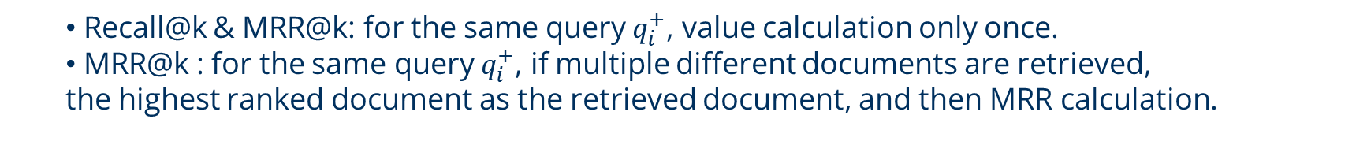
QID | PID+ | PID- | PID- | PID- | PID- | PID- | PID- | PID- | PID-
26 | 258 | 259 | 261 | 262 | 263 | 264 | 266 | 267 | 262
26 | 260 | 259 | 261 | 262 | 263 | 264 | 266 | 267 | 262
26 | 265 | 259 | 261 | 262 | 263 | 264 | 266 | 267 | 262
PID-
266
266
266
QID+ | QID- | PID
535060 | 535061 | 225618
535062 | 535063 | 225618
Recall@k & MRR@k: for the same query $q_{i}^{+}$, value calculation only once.
MRR@k : for the same query $q_{i}^{+}$, if multiple different documents are retrieved,
the highest ranked document as the retrieved document, and then MRR calculation.

Slide 35
Training and Evaluation – Hyperparameter Search
Manual Search Approach:
First Phase:
test the performance influence of each hyperparameter individually
Second Phase:
longer training on best hyperparameter setting

Slide 36
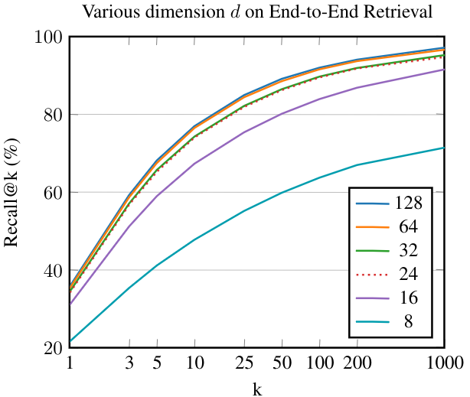
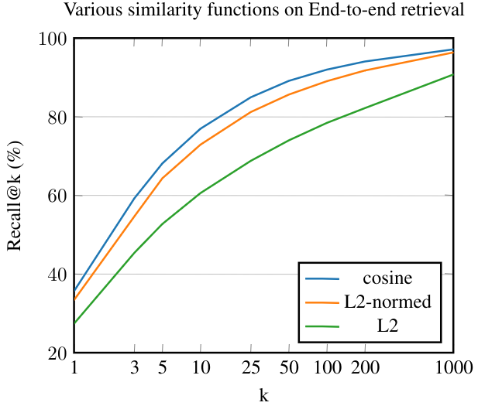
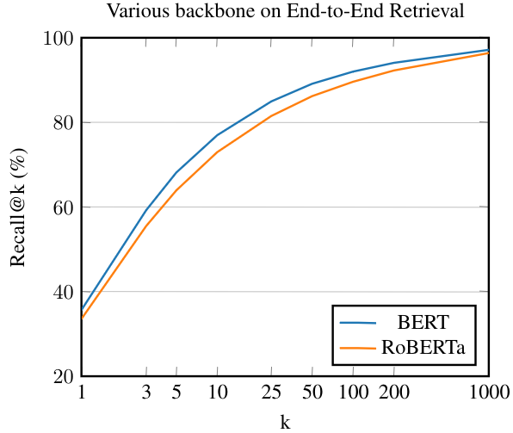
Training and Evaluation – Hyperparameter Search

Slide 37
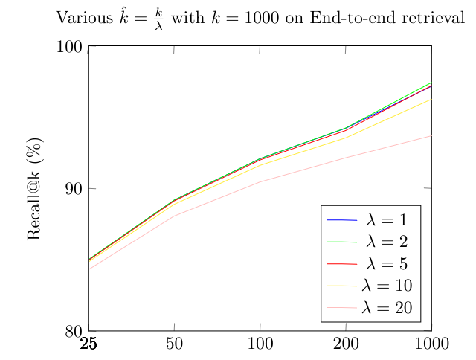
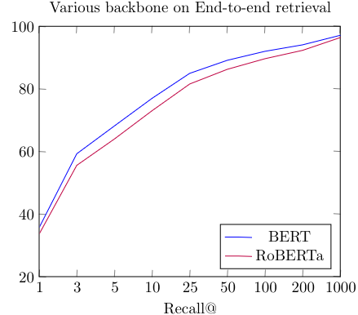
in contrast to the original paper we set $\hat{k}$ = $\frac{k}{5}$instead of $\hat{k}$ = $\frac{k}{2}$:
since both seem to yield similar performance while reducing the number of passages to rank and thus resulting in a more fair comparison to re-ranking and saving inference time.

Slide 38
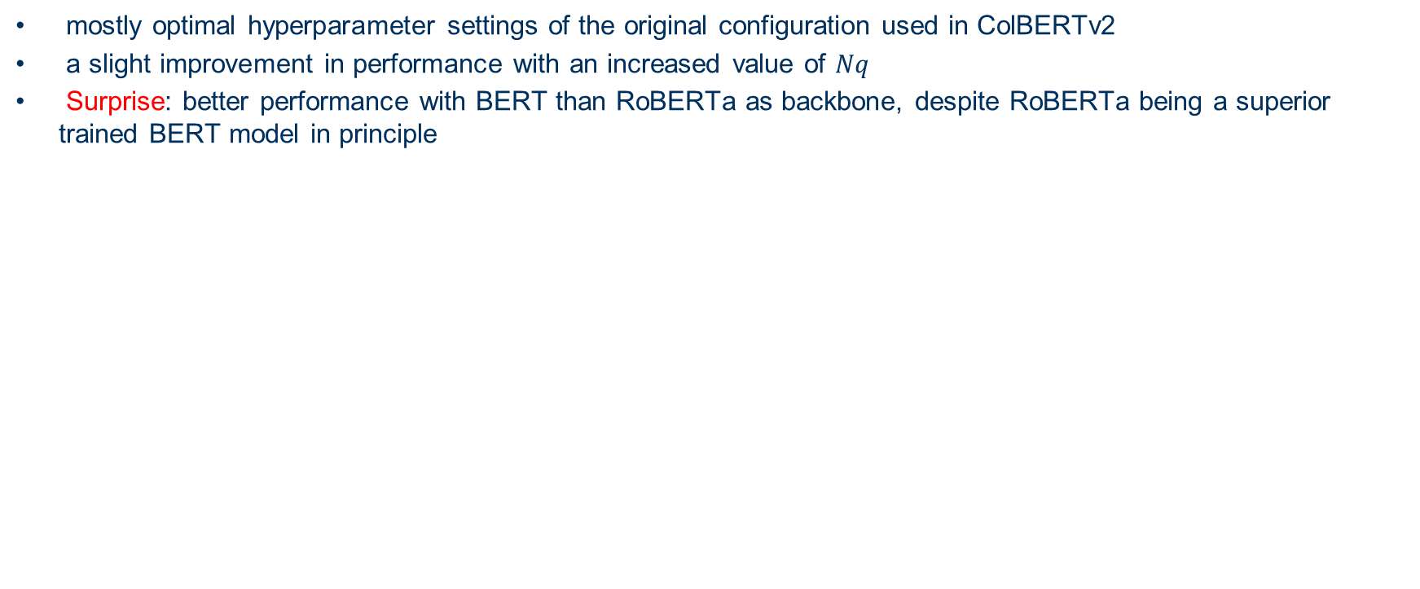
Validation
Base Configuration:
Dataset | MS MARCO v2.1
Backbone | BERT
Embedding dimensions | 128
Loss function | cross-entropy
Similarity function | cosine
Query embedding vector | 48
mostly optimal hyperparameter settings of the original configuration used in ColBERTv2
a slight improvement in performance with an increased value of $Nq$
Surprise: better performance with BERT than RoBERTa as backbone, despite RoBERTa being a superior trained BERT model in principle

Slide 39
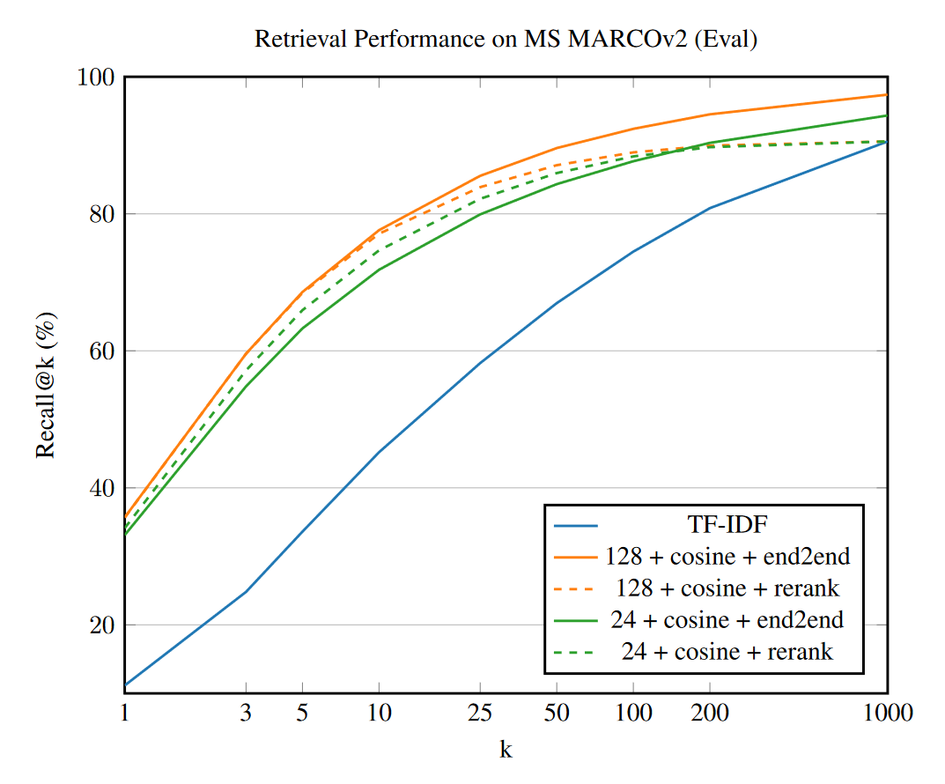
Pretraining
Training on 24 and 128 embedding dimension d
24 takes five times less space for precomputed embeddings, performs almost as well

Slide 40
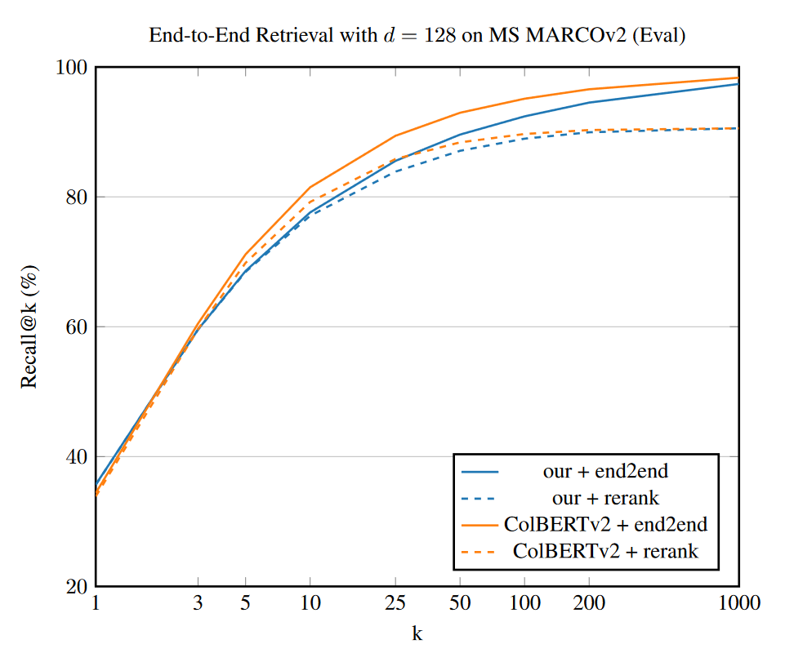
Comparison
comparing performance of our implementation and official ColBERTv2 model weights
Expected results because:
Training method like ColBERTv1

Slide 41
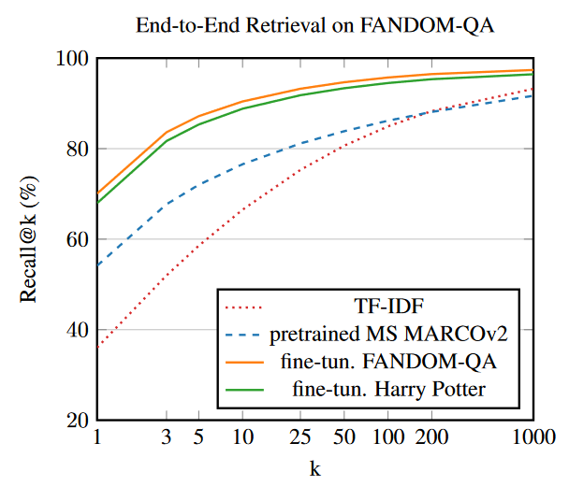
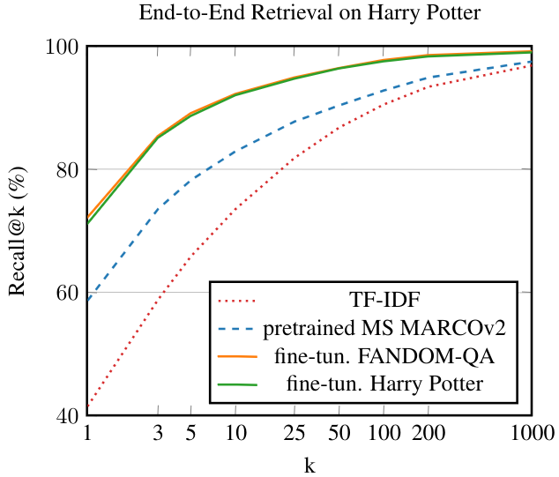
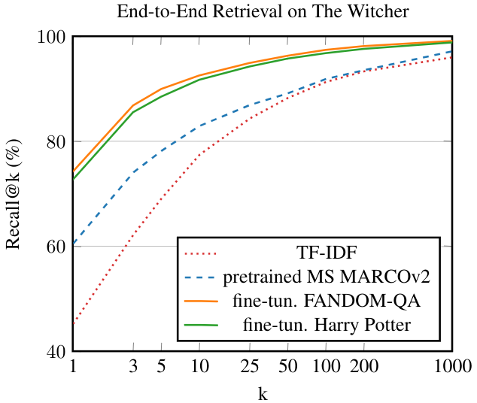
Fine Tuning
all runs with d = 24 and cosine similarity

Slide 42
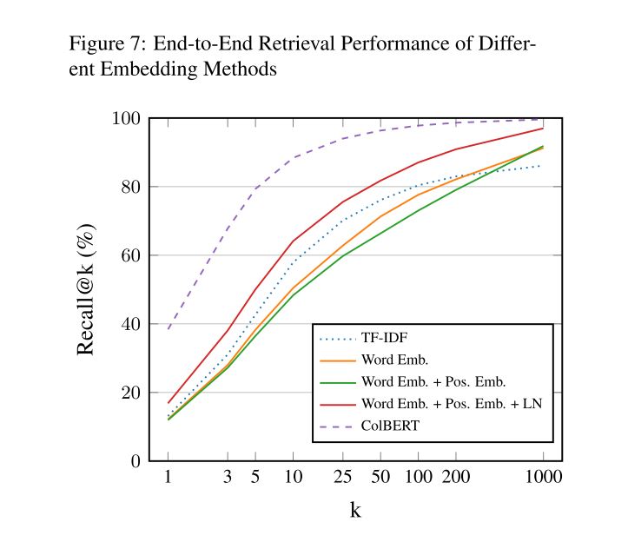
Appendix

Slide 43
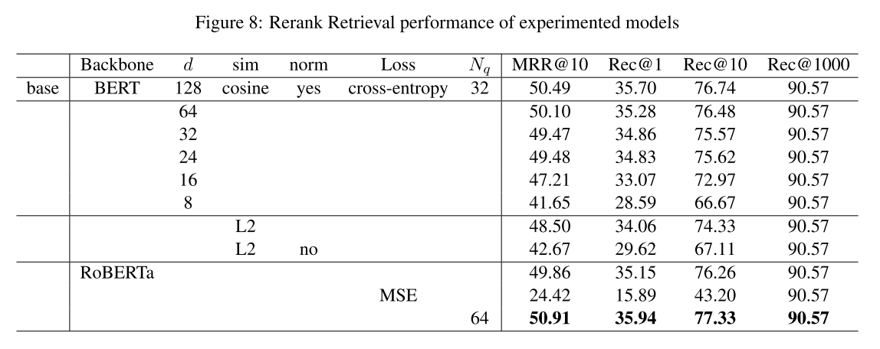

Slide 44
Model Interpretability and Explainability

Slide 45


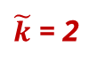

Interpretability - Relevance Score
top-$\tilde{k}$ Sim
top-$\tilde{k}$ Sim
top-$\tilde{k}$ Sim
$\tilde{k}$ = 2
0.2
0.1
0.8
0.7
0.9
0.5
Query Embeddings
1
2
3
1
2
3
4
Document Embeddings
who are you
i
am
bat
man
2 1 0 3
absolute count:
i
am
bat
man
0.8 + 0.7
0.9
0.5 + 0.2 + 0.1
accumulated similarities:
i
am
bat
man

Slide 46
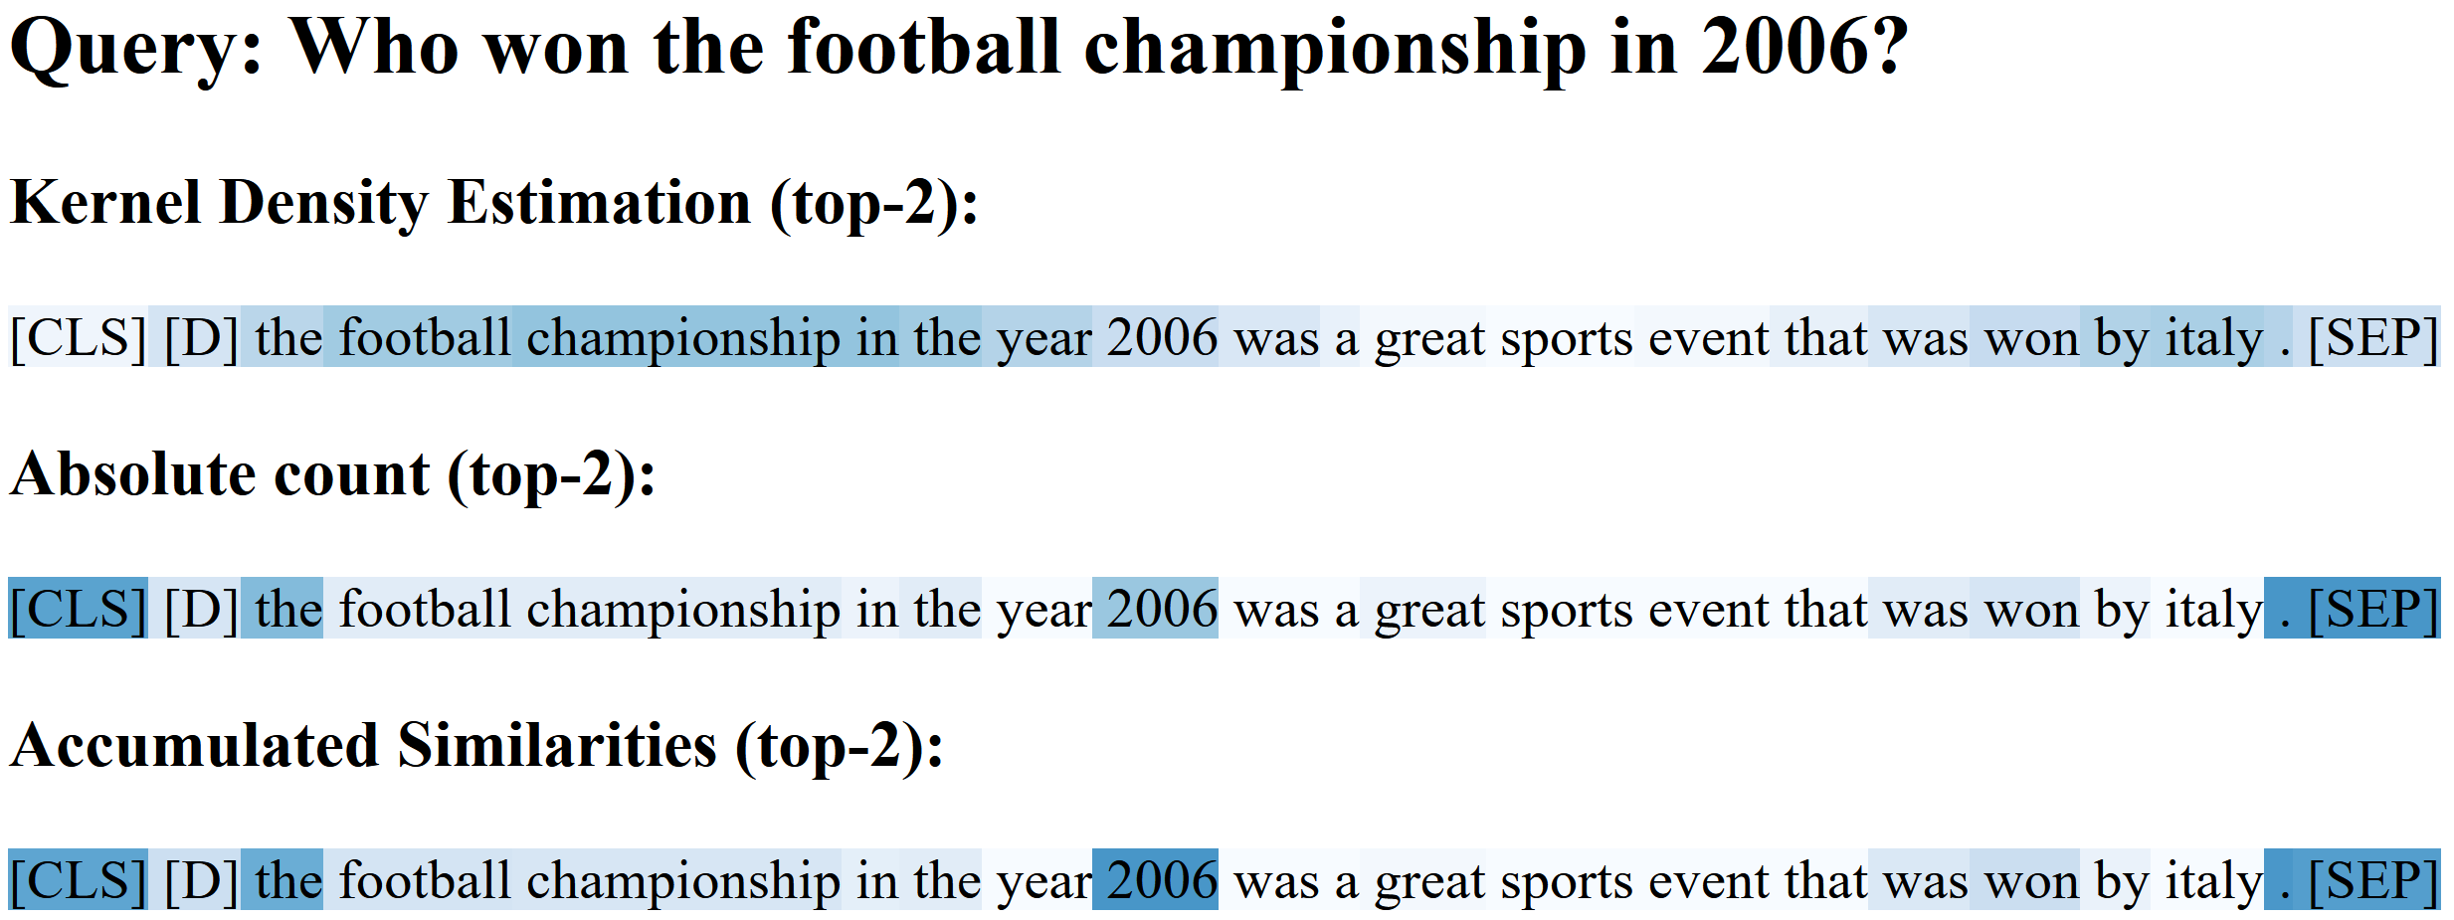
Example – Absolute Count, Accumulated Similarities
ColBERT was not trained to answer questions
highest similarities found in words that lead to the answer
actual answer is not relevant to decide whether the question is answered

Slide 47
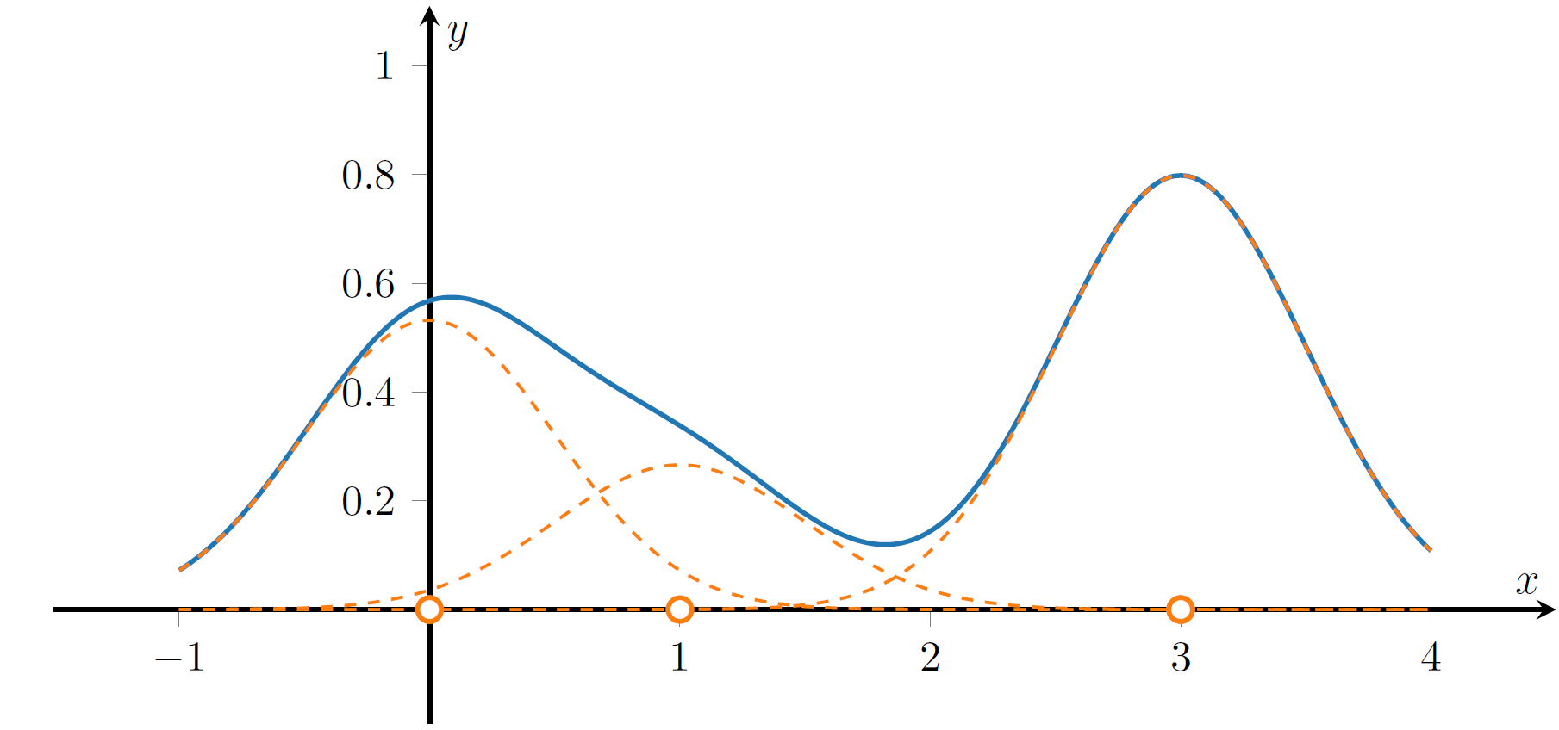
Locating the Answer in the Passage
Kernel Density Estimation (KDE):
assumption: the answer is located in areas with a high concentration of relevant tokens
absolute count:
2 1 0 3
i
am
bat
man

Slide 48
Locating the Answer in the Passage
assumption: the answer is located in areas with a high concentration of relevant tokens
[CLS]}, [D], [SEP] tokens are ignored by KDE

Slide 49
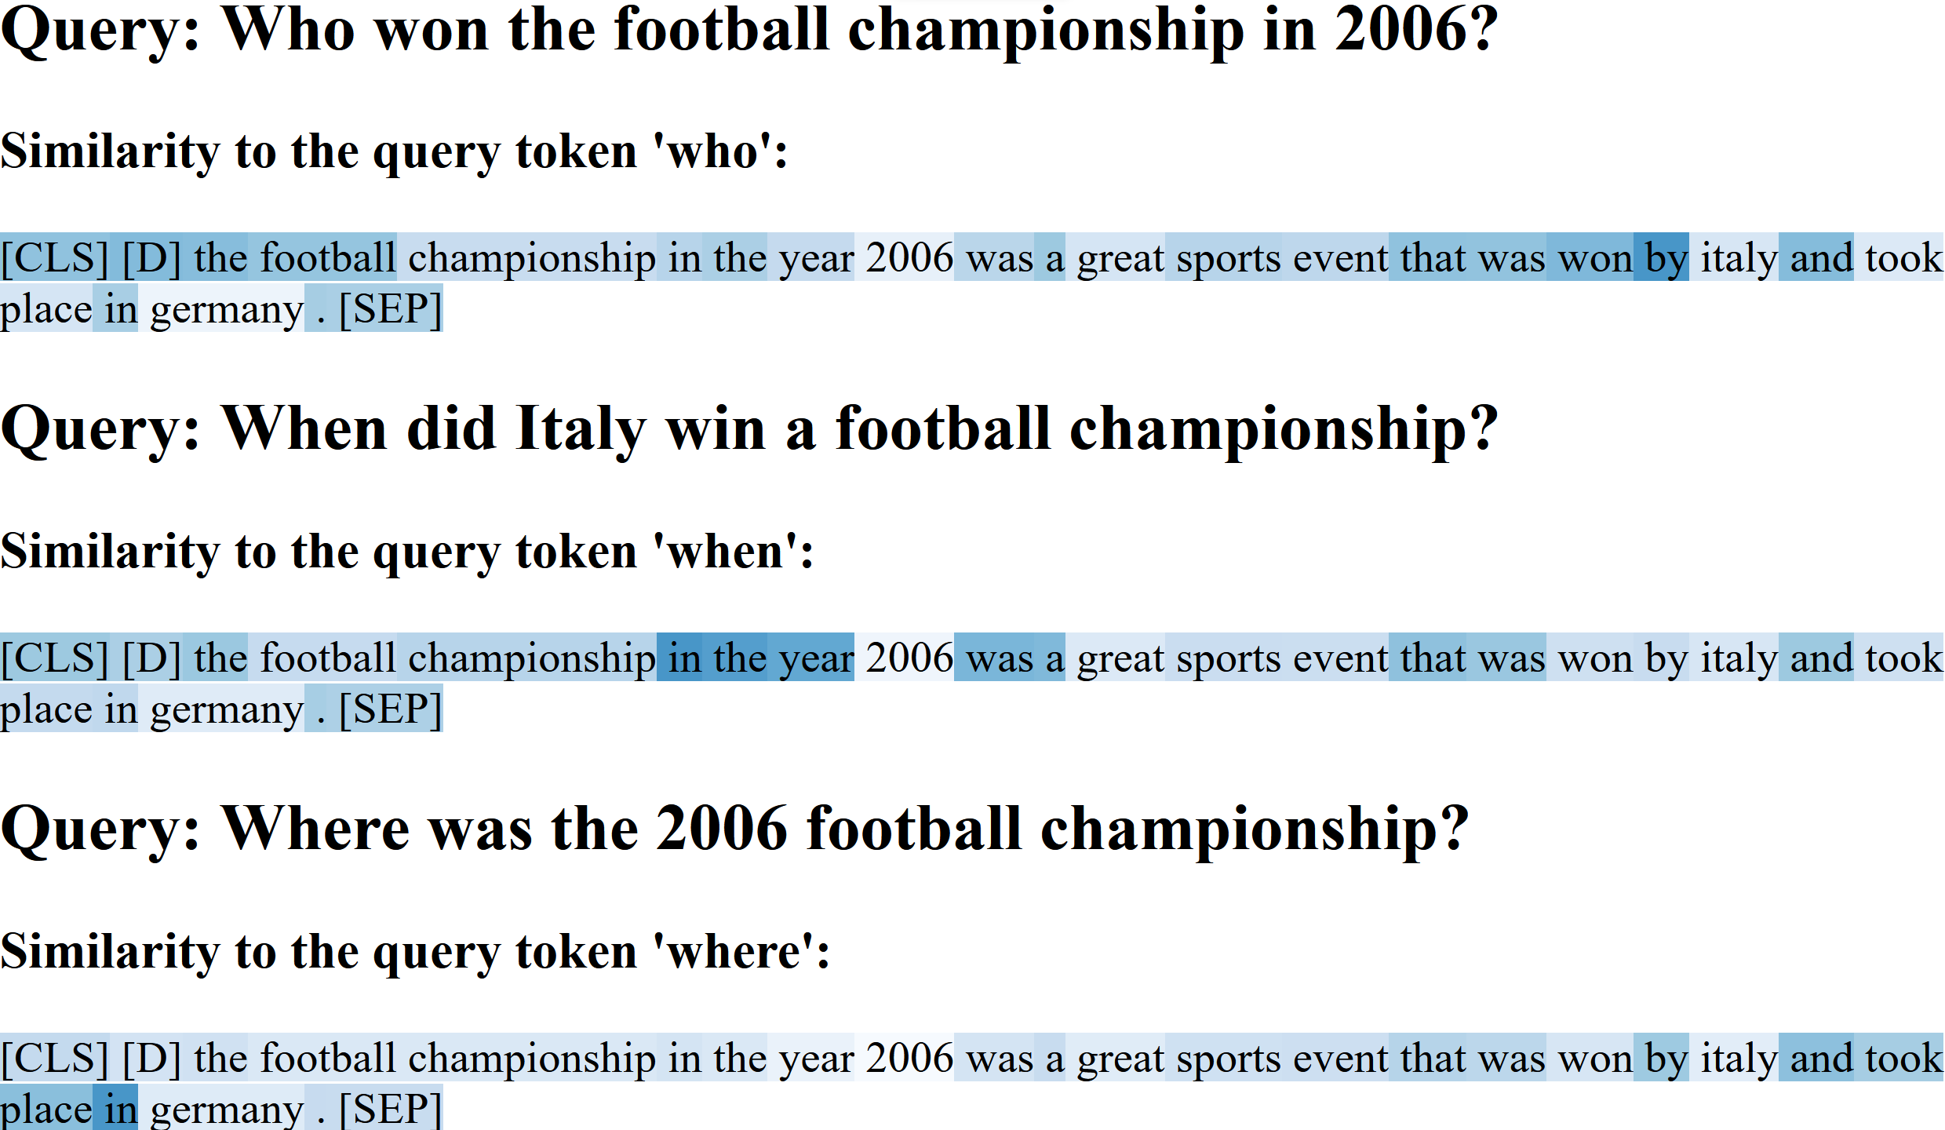
Example – Single Token Similarity

Slide 50
Demo System

